Slide 1
11th Lecture
Public sector initiatives for the provision of low income housing

Slide 2
Contents
Introduction
Public Sector Projects
  Korangi Town Project, Karachi
  Surjani Town, Karachi
  PHA Flats
  Ashiana Housing Scheme

Slide 3
Introduction
In 1947 when the country got independence, there was a large influx of immigrants from across the border who mostly settled in Karachi, followed by Lahore and Rawalpindi.
At that time the Government launched many resettlement schemes for low cost/low income category

Slide 4
Introduction
However, this momentum was not maintained. These cities continued to face the problem of large scale urbanization and the issue of illegal habitat/squatter settlements/slums.
In order to meet this challenge of Low Income/Low Cost Housing, we find very few examples of initiatives by the Public Sector. Following is a discussion of some important initiatives

Slide 5
Public Sector Projects
Korangi Town Project, Karachi
Surjani Town, Karachi
PHA Flats
Ashiana Housing Scheme

Slide 6
Korangi Town Project
In 1958, the Government launched two low income housing schemes for the rehabilitation of squatters under the “Greater Karachi Resettlement Program”, namely Korangi Township and North Karachi Township.
The projects were funded by the World Bank and were conceived and implemented in the early 60s by the then Governor General Azam Khan for the rehabilitation of squatters

Slide 7
Korangi Town Project
The project took a mere six months from the date of commencement to the handing over of the keys to the settlers.
The scheme initially did not have the desired success due to lack of essential services such as transport, schools and health services.
Also some of the allottees sold their rights in order to make money and then went back to their slums
However, over a few years time, with the development of missing infra structure, the project turned out to be a great success

Slide 8
Surjani Town Project
The low income housing scheme was launched in Deh Surjani in the late 80s.
The housing project consisted of building 10,000 housing units, consisting of 1-2 rooms accommodation.
It was to be implemented by Karachi Development authority (KDA) with the financial assistance from the World Bank
Under the scheme, pieces of land were allocated to different Developers/Builders for construction according to the laid out plans/designs.

Slide 9
Surjani Town Project
The builders were required to do construction using low cost technologies and preferably low cost construction materials such as Steel Mill Slag and Pre-cast slabs, etc.
The cost of one-room unit of 280 Sq.Ft covered area was Rs 40,000 and two-room unit of 385 Sq.Ft covered area was Rs 48,000.
This included the cost of land @ Rs 8,000 per plot as subsidized by the Government.

Slide 10
Surjani Town Project
The House Building Finance Corporation (HBFC) provided mortgage finance to people needing financial assistance and HBFC financing was commenced in 1987-88.
The average loan size from HBFC per client was Rs 35,000
In this case also the construction of housing units was not supported by a simultaneous provision of residential infrastructure such as water, electricity, health clinics, schools, and especially transport to the city

Slide 11
Surjani Town Project
In the absence of transport facilities the low income people found it difficult to commute to the city in order to earn their living.
As a result, most of the units remained unoccupied for a much longer period. This resulted in loan default to HBFC, who was unable to do any foreclosure as well.
As of 2006-7 nearly 7,500 HBFC accounts in the area were Non-Performing with an outstanding loan of about Rs 557 million

Slide 12
PHA Flats
PHA Foundation is a Public Company registered with Securities and Exchange Commission of Pakistan under Section 42 of the Companies Ordinance, 1984.
Being one of the implementing arms of Ministry of Housing & Works, PHA Foundation is consistently striving to eliminate shelterlessness and to reduce the housing shortfall in Pakistan.

Slide 13
PHA Flats
After successful provision of Ground plus 3 building apartments, PHAF is now striving at constructing high rise buildings.
Construction of PHA-Maymar Towers in Karachi is first endeavor in this respect. PHAF has also initiated projects for provision of houses and open plots.

Slide 14
Basis of categorization
Flats are categorized on the basis of covered area, following are the covered areas of each type
To be added

Slide 15
Types of Flats
PHA has categorized the apartments in to following 4 categories
A type
B type
C type
D type

Slide 16
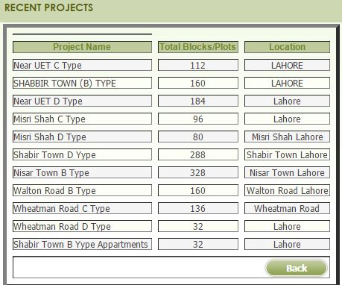
PHA projects in Lahore

Slide 17
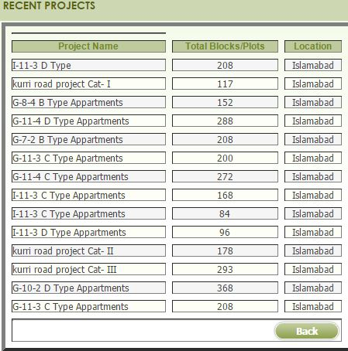
PHA projects in Islamabad

Slide 18
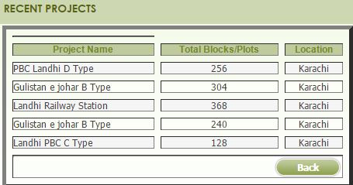
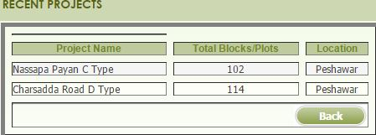
PHA projects in Karachi & Peshawar

Slide 19
Ashiana Housing Scheme
Ashiana Housing Scheme is for those people who have not their own homes. In the history of Pakistan, Punjab Government has announced biggest residential scheme for people with low income.
Govt of Punjab is constructing thousands of flats for needy people. In the first phase of scheme homes are built at ideal location at Barki Road Lahore. It’s names is Ahsiana Iqbal Lahore

Slide 20
Introduction to PLDC…
Land and Urban development in Punjab is under tremendous pressure from uncontrolled urban sprawl, deteriorating environment, deficiencies in basic services, shortages in the provision of housing, and absence of properly developed spaces for economic activity, industrial estates, technology parks and related infrastructure.
Vision of PLDC is to provide “affordable and decent adobe to the people who have desires but don’t have the resources to fulfill their basic needs of shelter”.

Slide 21
Continue…
This scheme will increases to other cities of Punjab including Faisalabad, Rawalpindi, Sargodha, Bahawalpur, Multan, Gujrat, Gujranwala, Sialkot and other cities of Punjab
Location of Ashiana Housing Scheme is also very near to cities centers are in approach from main roads. Ready homes will be given to those applicants who will win their names in draws

Slide 22
Features of Ashiana Housing Schemes
…
Prices of the flats start from 11 lac and 99 thousand rupees only.
Complete ready flats with single or double bedroom and other.
Interest free installment (8 thousand rupees monthly).
Flats will be allotted only on transparent draw and all will be done just on merit.

Slide 23
Eligibility Conditions
…
  Applicant must have NIC from Punjab province. People from other provinces cannot apply for this scheme.
  Total income of whole family must have below than 50 thousand rupees including (father, mother, brother, sister, wife, husband, children etc).
  Applicant mustn’t have any flat, house or any residential or commercial plot etc.
  Age limit is 55 years till last date of application.
  Those people who have already participated in Ashiana scheme in past and have now their homes, can not apply for this scheme.

Slide 24
Structure of Houses
Ashiana Housing Project offers two categories of housing units to cater for the variety of its valued customers, as follows:
2-Marla Housing Unit
3-Marla Housing Unit

Slide 25
Application FormFinal Lectures\Housing 10th lecture 2.JPG
Final Lectures\Housing 10th lecture 3.JPG

Slide 26
Ashiana Home Payment Plans
…
Ashiana Housing scheme is only for those people who don’t have their own home or residential plot and have low income. Govt of Punjab has started this scheme with very best payment plans. Below is the detail of total price and installments etc.

Slide 27
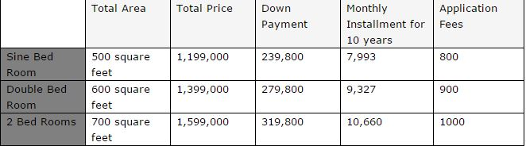
Ashiana Home Payment Plans
……

Slide 28
Continue…
Asian housing scheme has lot of facilities and is one of the best and latest housing projects in Asia by any government. It has facilities including
School
Parks
Mosque
Wide roads
Commercial areas
Health Clubs
Community Centre
(One of Ashiana phase will be discussed in detail in coming lecture)

Slide 29
References
http://www.pha.gov.pk/Default.aspx
http://www.phamaymar.com/pha-maymar-projects.html
http://www.pldc.gop.pk/location-maps.html

